Slide 1
Input/Output
Chapter 5
5.1 Principles of I/O hardware
5.2 Principles of I/O software
5.3 I/O software layers
5.4 Disks
5.5 Clocks
5.6 Character-oriented terminals
5.7 Graphical user interfaces
5.8 Network terminals
5.9 Power management

Slide 2
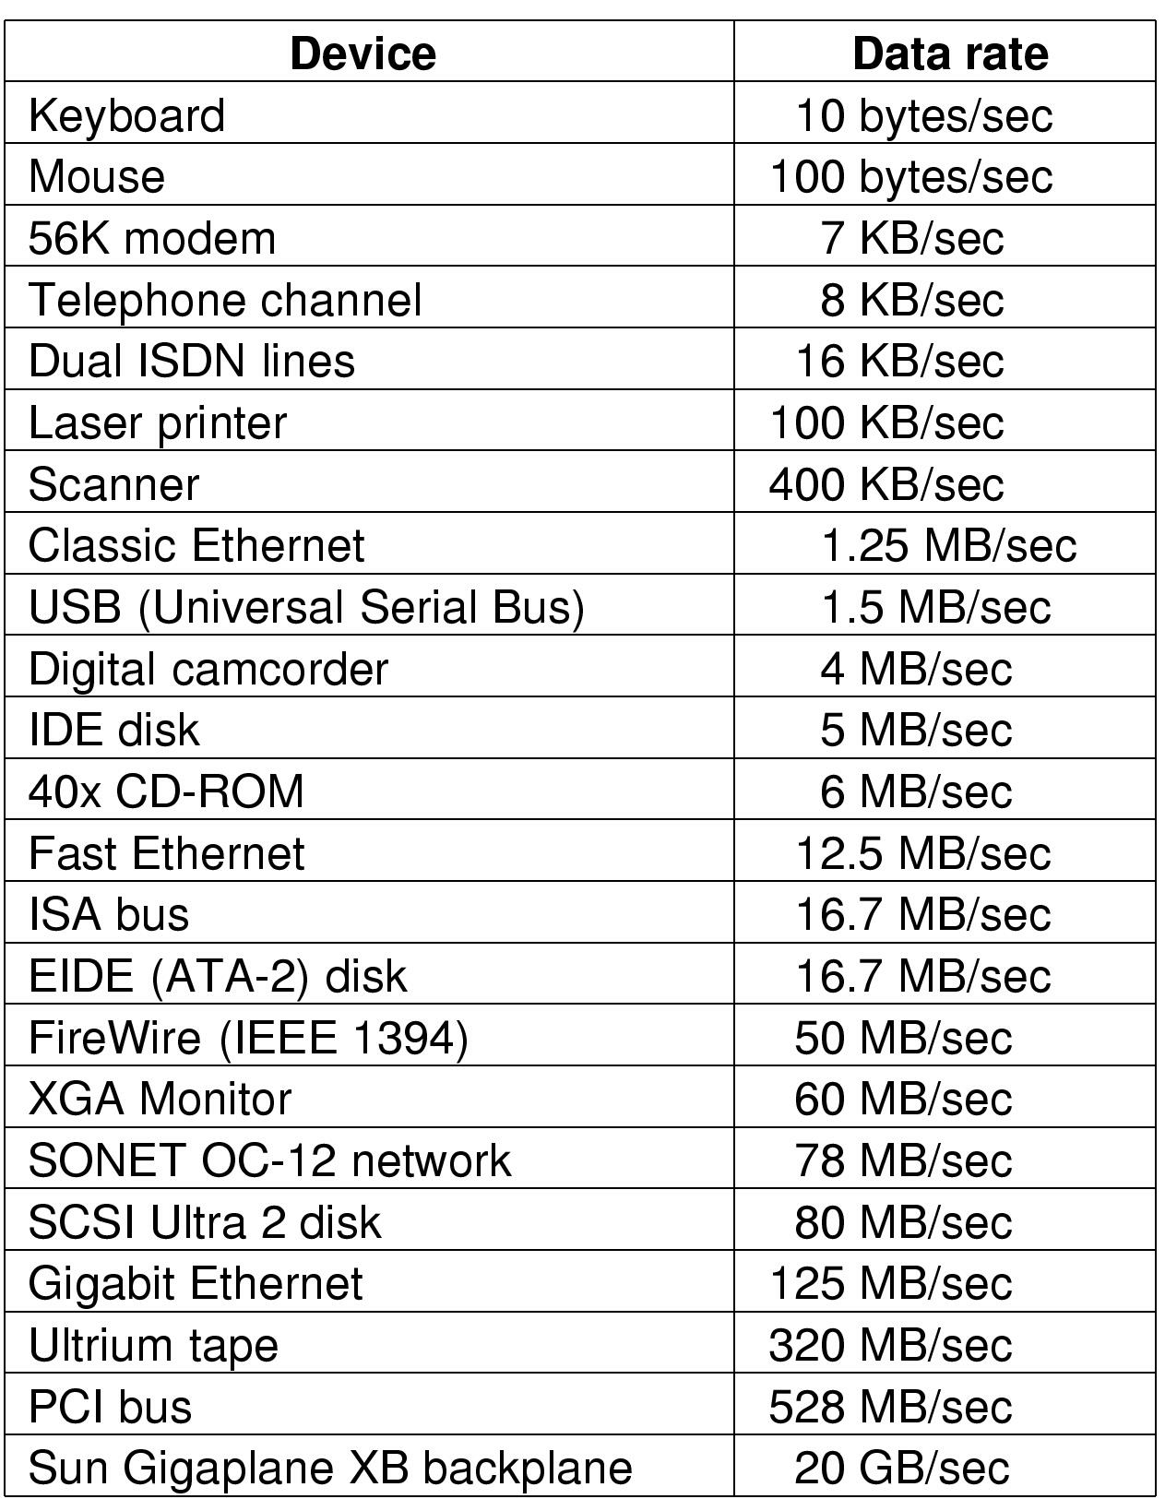
Principles of I/O Hardware
Some typical device, network, and data base rates

Slide 3
Device Controllers
I/O devices have components:
  mechanical component
  electronic component
The electronic component is the device controller
  may be able to handle multiple devices
Controller's tasks
  convert serial bit stream to block of bytes
  perform error correction as necessary
  make available to main memory

Slide 4
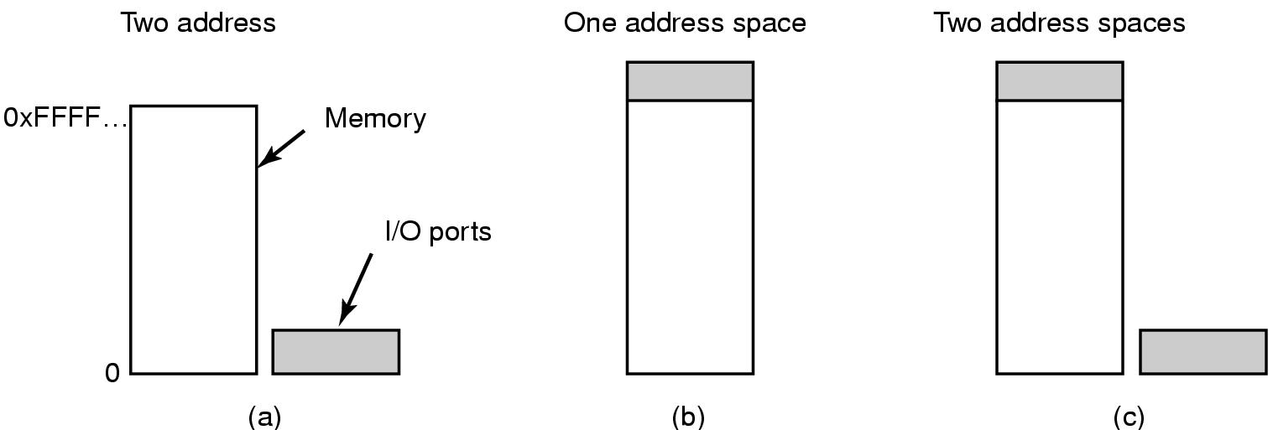
Memory-Mapped I/O (1)
Separate I/O and memory space
Memory-mapped I/O
Hybrid

Slide 5
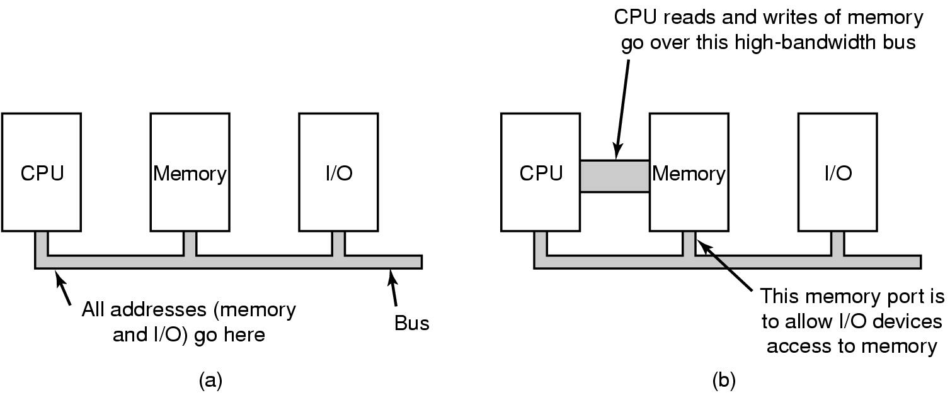
Memory-Mapped I/O (2)
(a) A single-bus architecture
(b) A dual-bus memory architecture

Slide 6

Direct Memory Access (DMA)
Operation of a DMA transfer

Slide 7

Interrupts Revisited
How interrupts happens. Connections between devices and interrupt controller actually use interrupt lines on the bus rather than dedicated wires

Slide 8
Principles of I/O Software
Goals of I/O Software (1)
Device independence
  programs can access any I/O device
  without specifying device in advance
    (floppy, hard drive, or CD-ROM)
Uniform naming
  name of a file or device a string or an integer
  not depending on which machine
Error handling
  handle as close to the hardware as possible

Slide 9
Goals of I/O Software (2)
Synchronous vs. asynchronous transfers
  blocked transfers vs. interrupt-driven
Buffering
  data coming off a device cannot be stored in final destination
Sharable vs. dedicated devices
  disks are sharable
  tape drives would not be

Slide 10
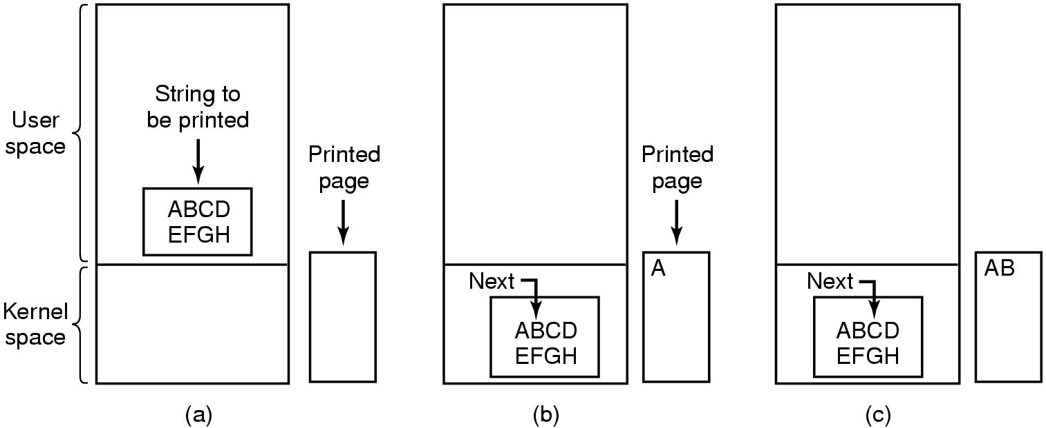
Programmed I/O (1)
Steps in printing a string

Slide 11
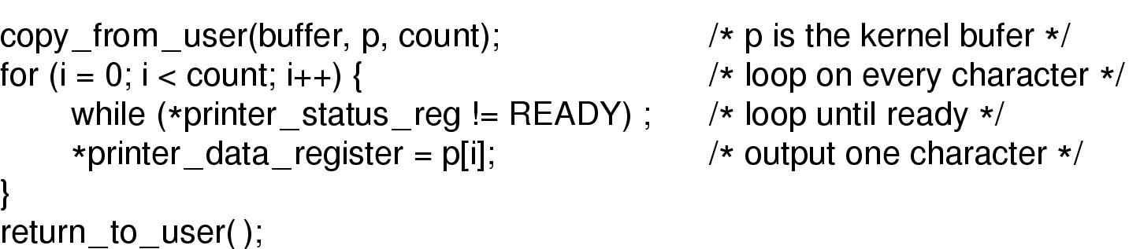
Programmed I/O (2)
Writing a string to the printer using programmed I/O

Slide 12
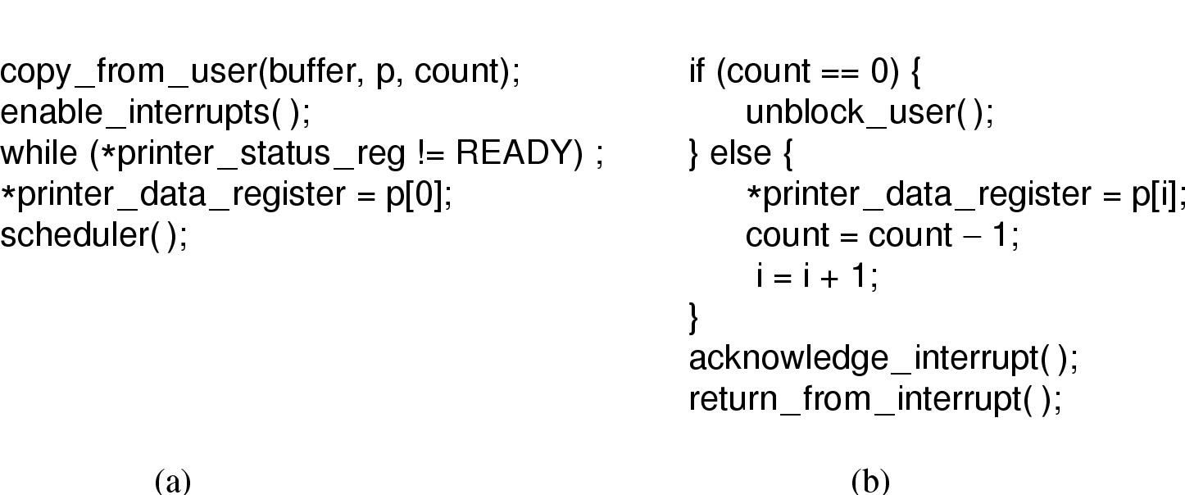
Interrupt-Driven I/O
Writing a string to the printer using interrupt-driven I/O
  Code executed when print system call is made
  Interrupt service procedure

Slide 13
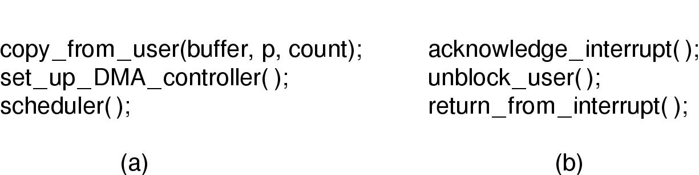
I/O Using DMA
Printing a string using DMA
  code executed when the print system call is made
  interrupt service procedure

Slide 14
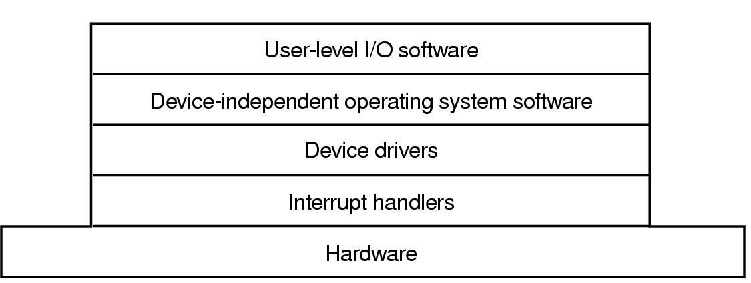
I/O Software Layers
Layers of the I/O Software System

Slide 15
Interrupt Handlers (1)
Interrupt handlers are best hidden
  have driver starting an I/O operation block until interrupt notifies of completion
Interrupt procedure does its task
  then unblocks driver that started it
Steps must be performed in software after interrupt completed
  Save regs not already saved by interrupt hardware
  Set up context for interrupt service procedure

Slide 16
Interrupt Handlers (2)
  Set up stack for interrupt service procedure
  Ack interrupt controller, reenable interrupts
  Copy registers from where saved
  Run service procedure
  Set up MMU context for process to run next
  Load new process' registers
  Start running the new process

Slide 17
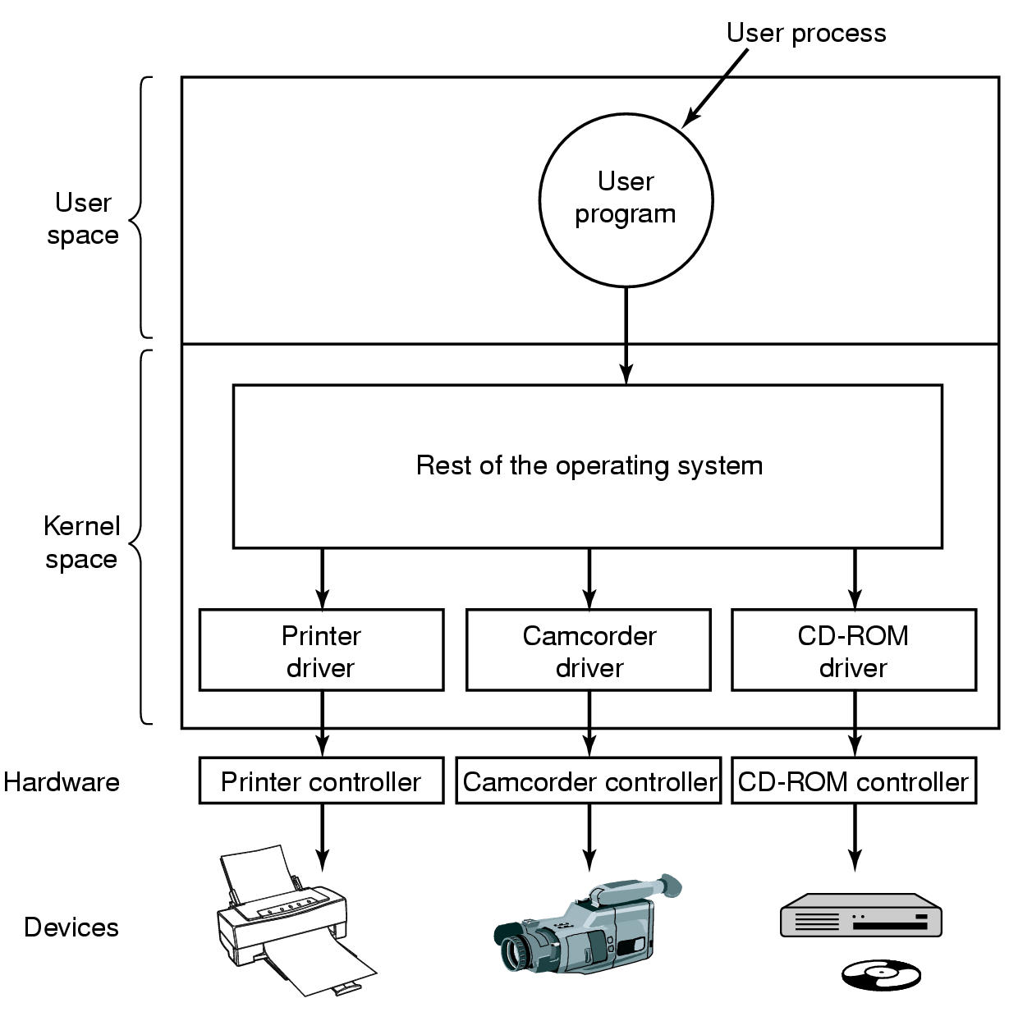
Device Drivers
Logical position of device drivers is shown here
Communications between drivers and device controllers goes over the bus

Slide 18
Device-Independent I/O Software (1)
Uniform interfacing for device drivers
Buffering
Error reporting
Allocating and releasing dedicate devices
Providing a deice-independent block size
Functions of the device-independent I/O software

Slide 19
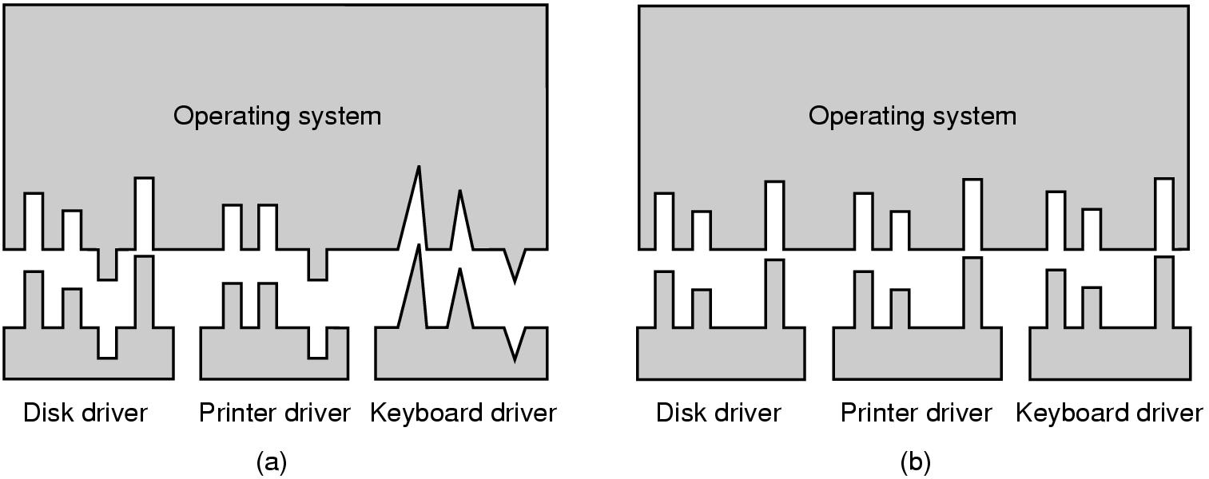
Device-Independent I/O Software (2)
(a) Without a standard driver interface
(b) With a standard driver interface

Slide 20
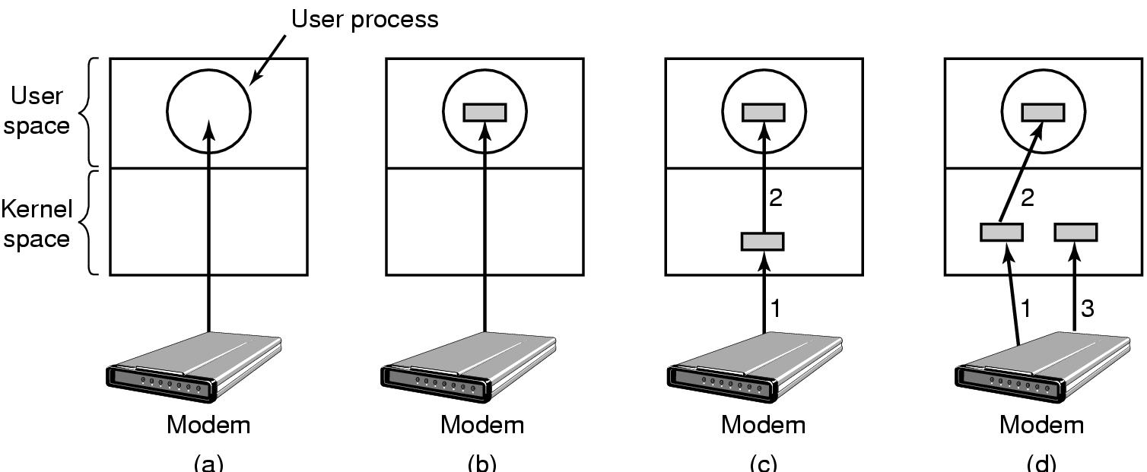
Device-Independent I/O Software (3)
(a) Unbuffered input
(b) Buffering in user space
(c) Buffering in the kernel followed by copying to user space
(d) Double buffering in the kernel

Slide 21
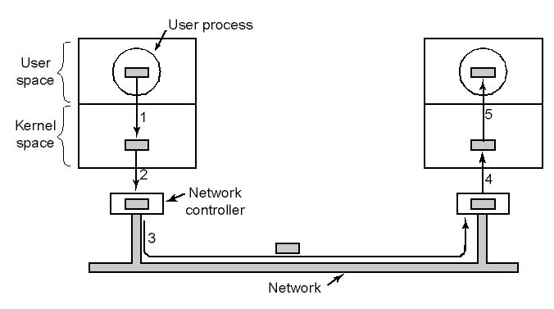
Device-Independent I/O Software (4)
Networking may involve many copies

Slide 22
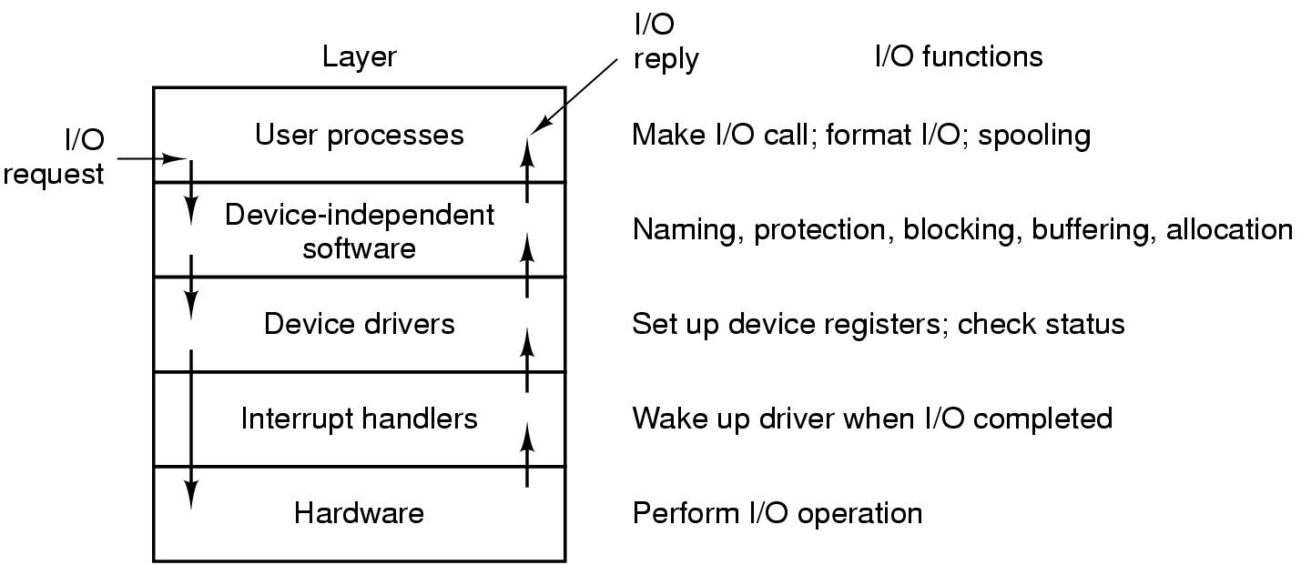
User-Space I/O Software
Layers of the I/O system and the main functions of each layer

Slide 23
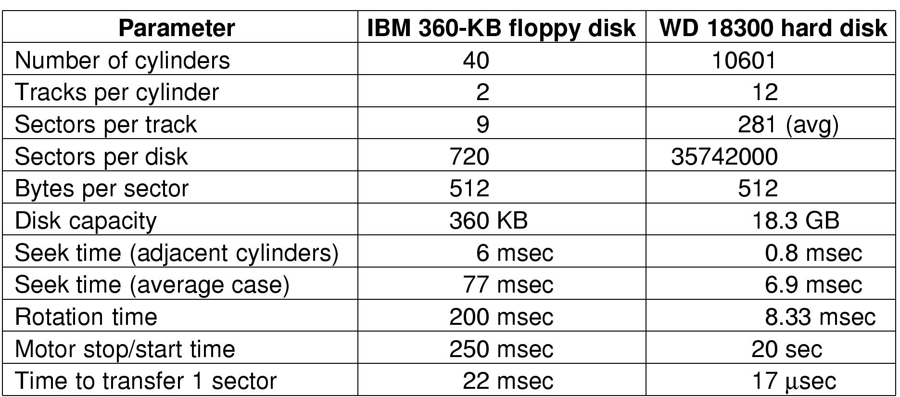
Disks
Disk Hardware (1)
Disk parameters for the original IBM PC floppy disk and a Western Digital WD 18300 hard disk

Slide 24
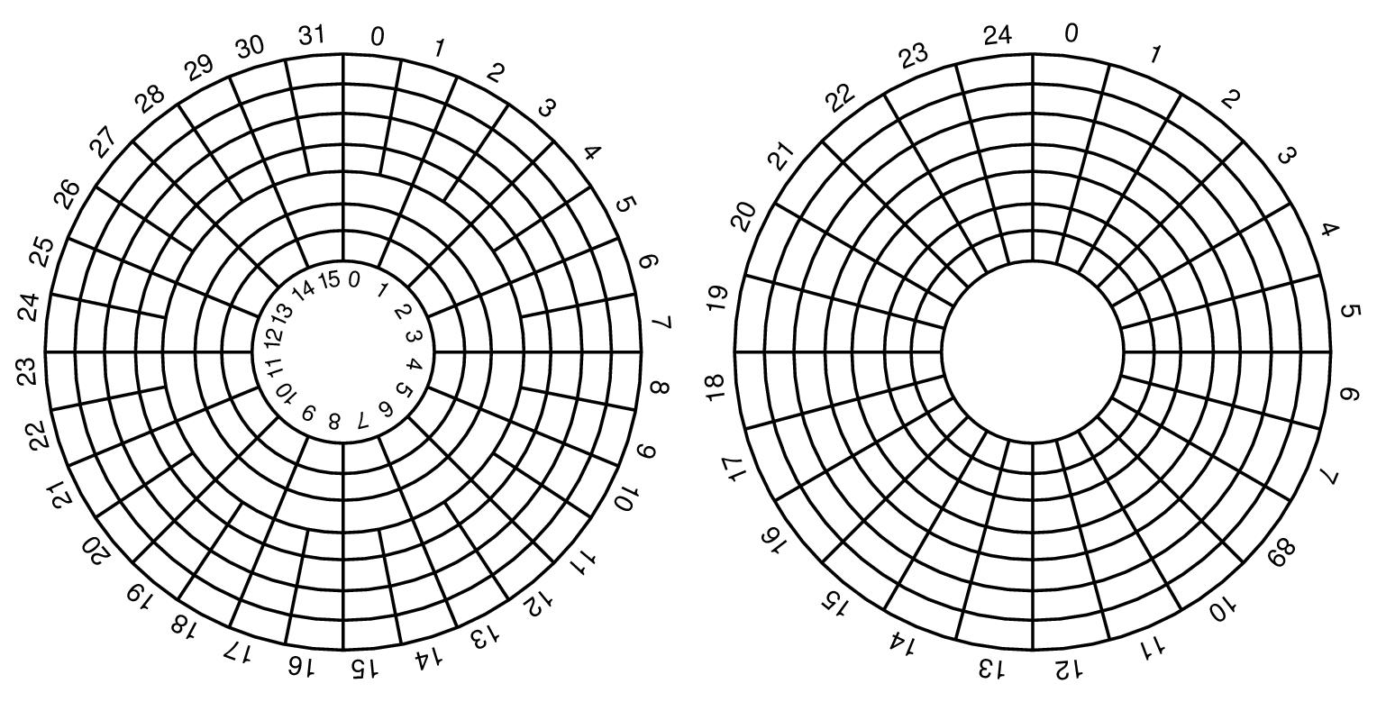
Disk Hardware (2)
Physical geometry of a disk with two zones
A possible virtual geometry for this disk

Slide 25
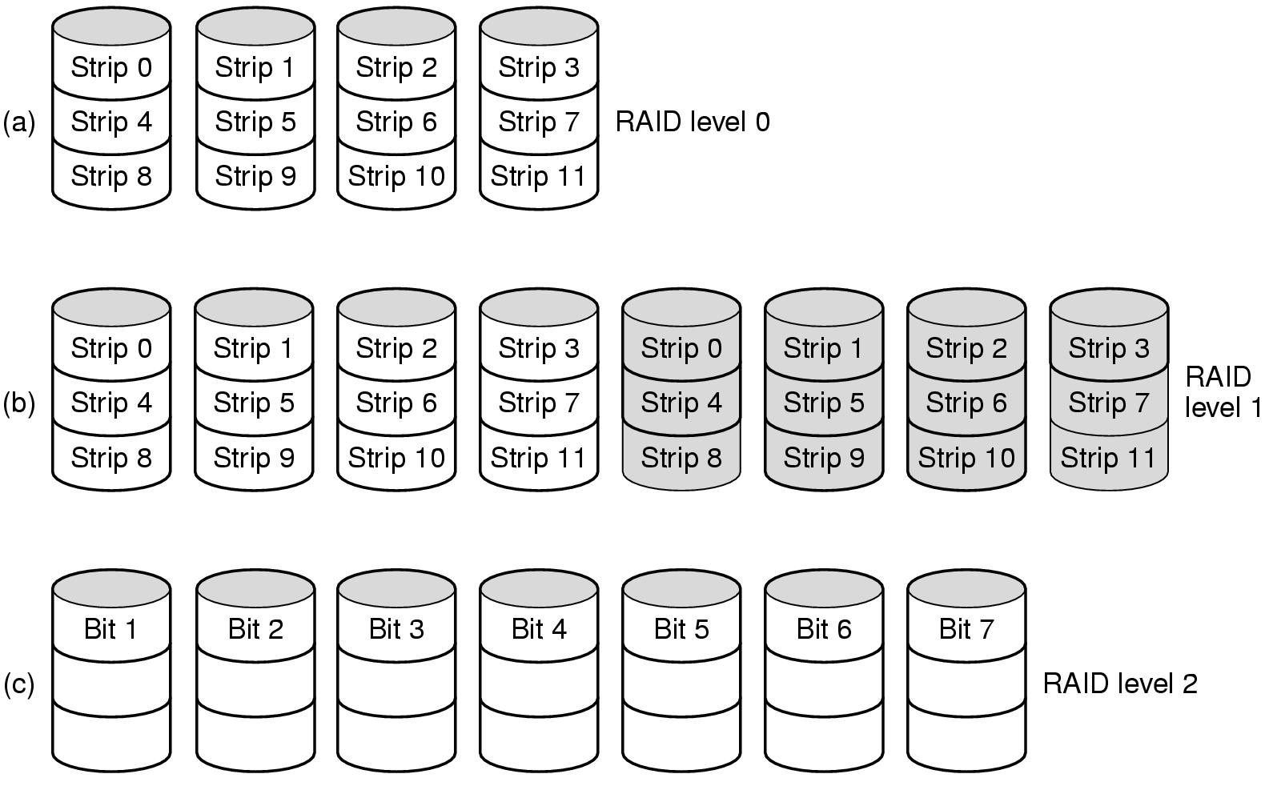
Disk Hardware (3)
Raid levels 0 through 2
Backup and parity drives are shaded

Slide 26
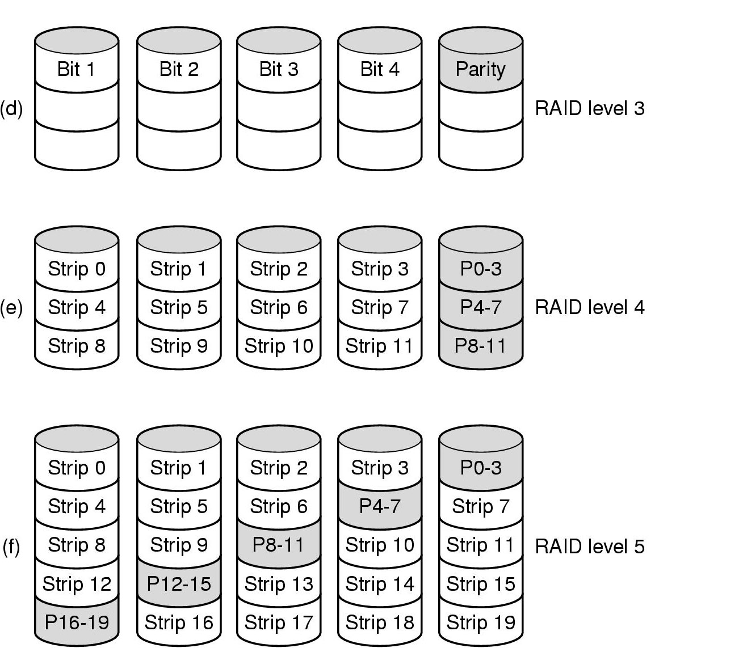
Disk Hardware (4)
Raid levels 3 through 5
Backup and parity drives are shaded

Slide 27
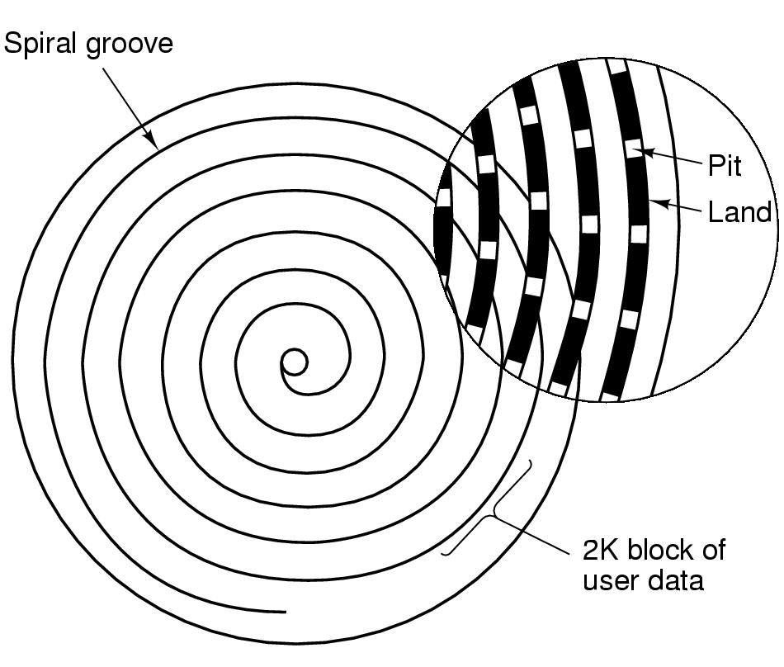
Disk Hardware (5)
Recording structure of a CD or CD-ROM

Slide 28
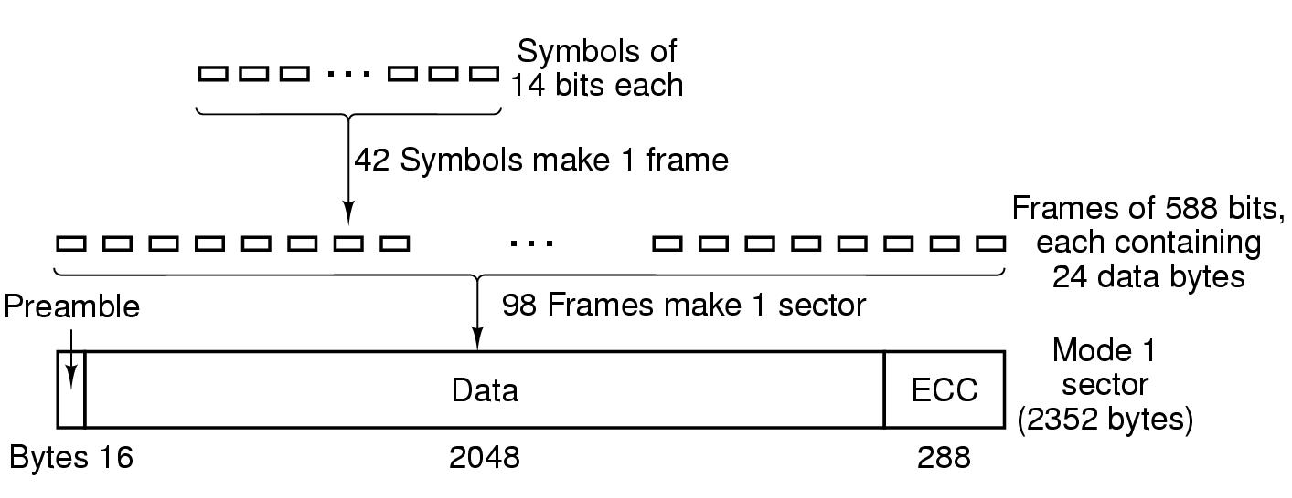
Disk Hardware (6)
Logical data layout on a CD-ROM

Slide 29
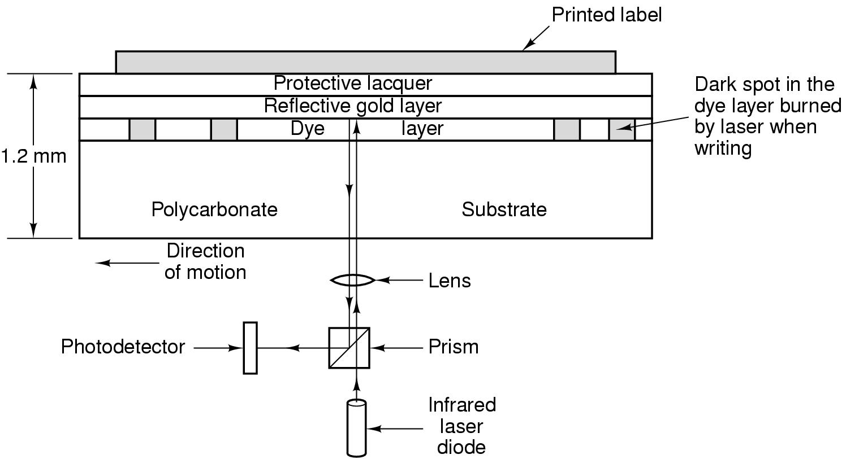
Disk Hardware (7)
Cross section of a CD-R disk and laser
  not to scale
Silver CD-ROM has similar structure
  without dye layer
  with pitted aluminum layer instead of gold

Slide 30
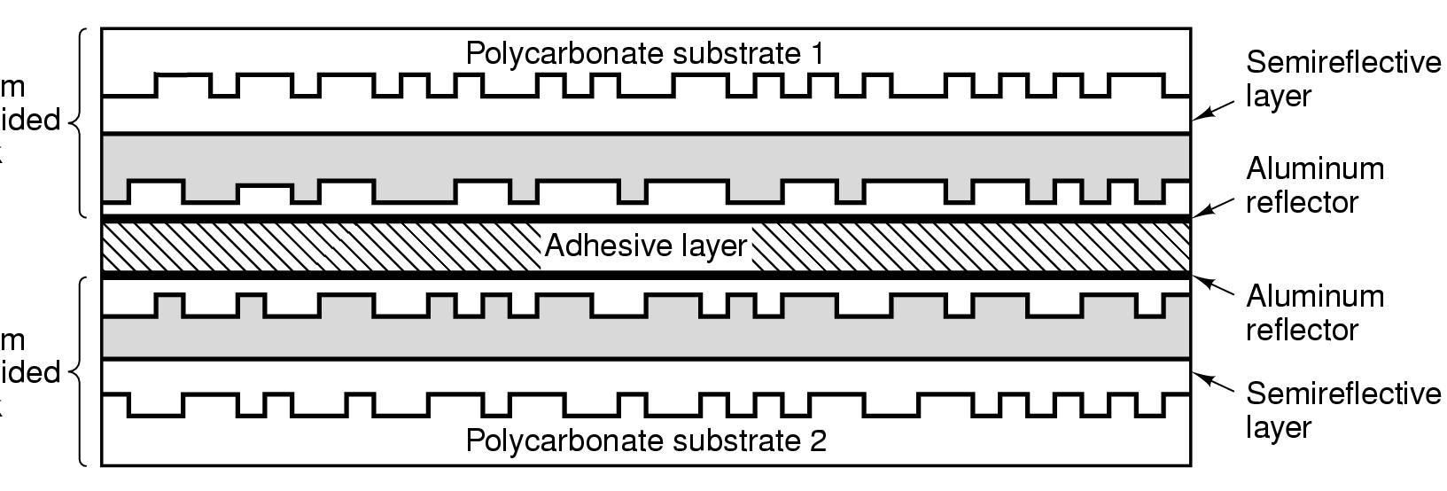
Disk Hardware (8)
A double sided, dual layer DVD disk

Slide 31
Disk Formatting (1)
A disk sector

Slide 32
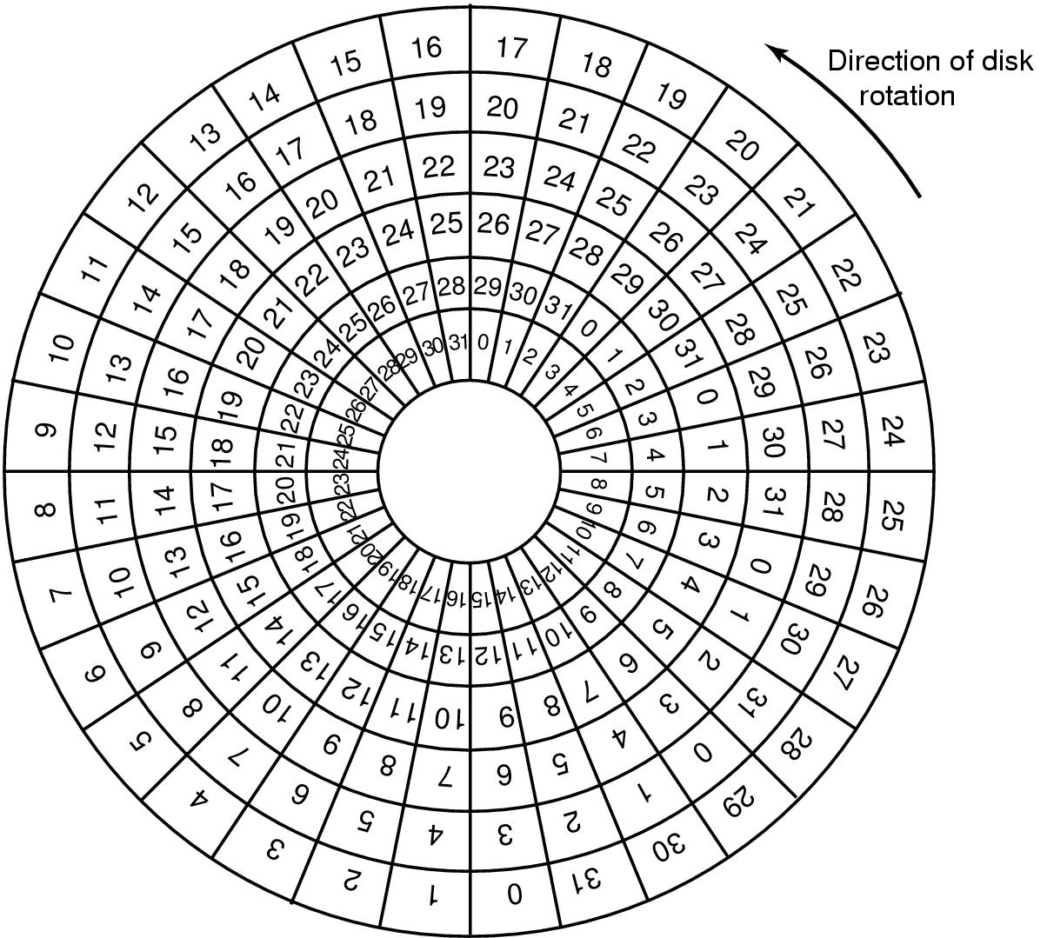
Disk Formatting (2)
An illustration of cylinder skew

Slide 33
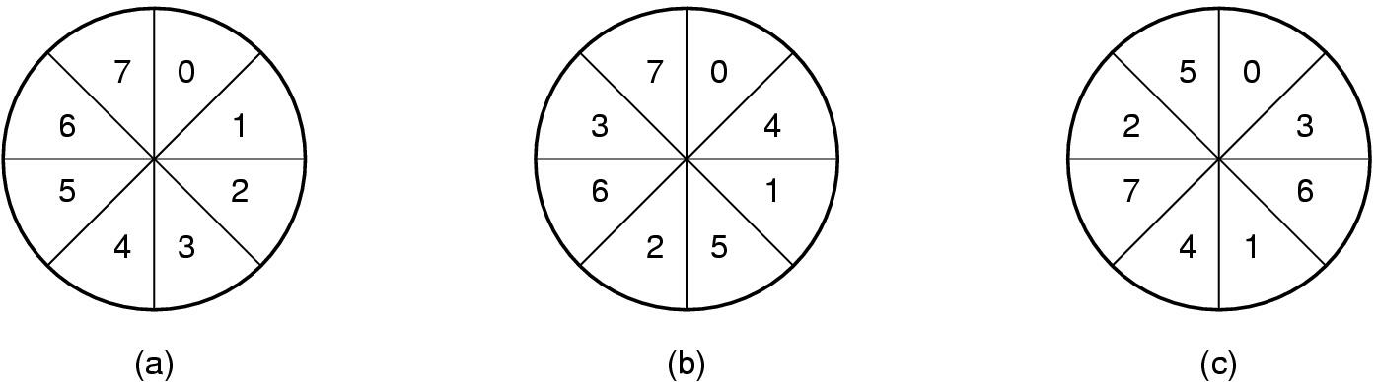
Disk Formatting (3)
No interleaving
Single interleaving
Double interleaving

Slide 34
Disk Arm Scheduling Algorithms (1)
Time required to read or write a disk block determined by 3 factors
  Seek time
  Rotational delay
  Actual transfer time
Seek time dominates
Error checking is done by controllers

Slide 35
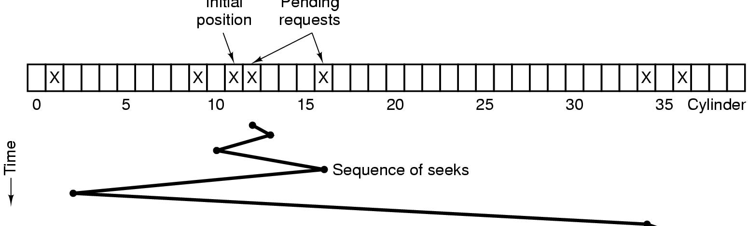
Disk Arm Scheduling Algorithms (2)
Initial
position
Pending
requests
Shortest Seek First (SSF) disk scheduling algorithm

Slide 36
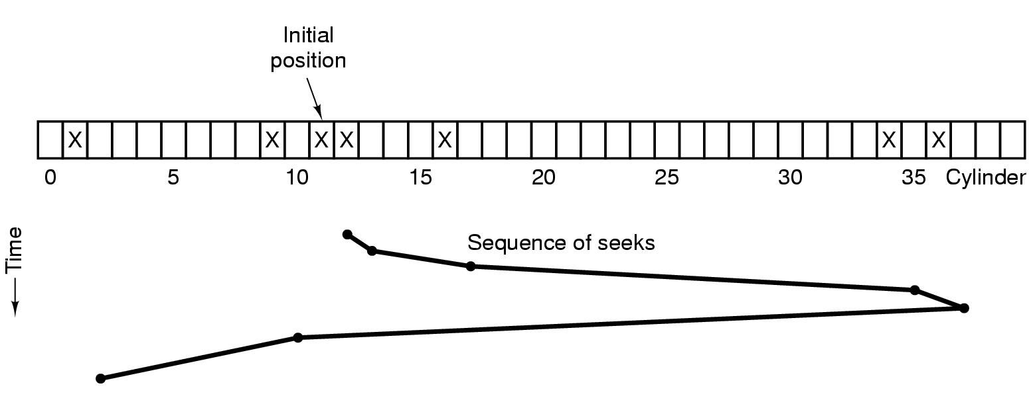
Disk Arm Scheduling Algorithms (3)
The elevator algorithm for scheduling disk requests

Slide 37
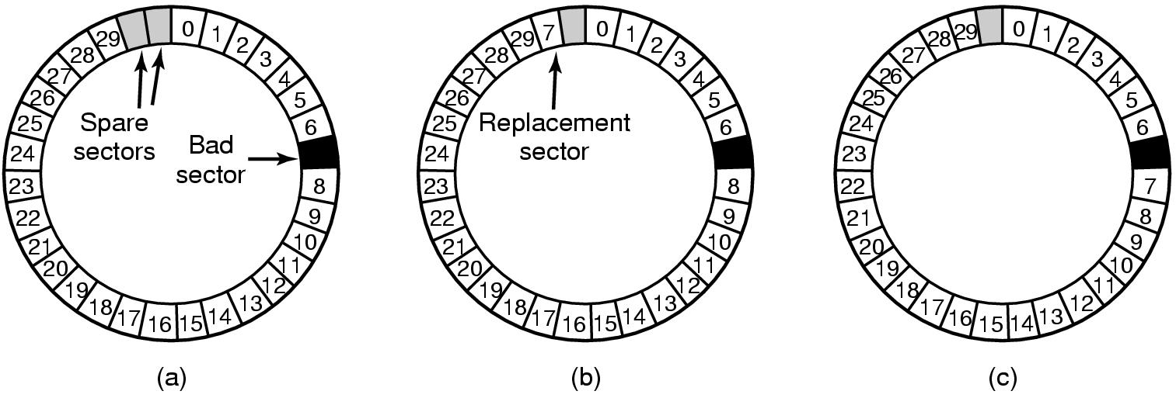
Error Handling
A disk track with a bad sector
Substituting a spare for the bad sector
Shifting all the sectors to bypass the bad one

Slide 38
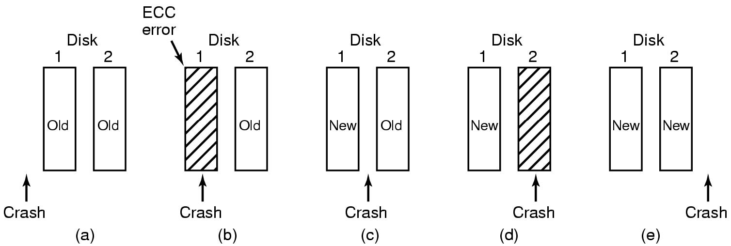
Stable Storage
Analysis of the influence of crashes on stable writes

Slide 39
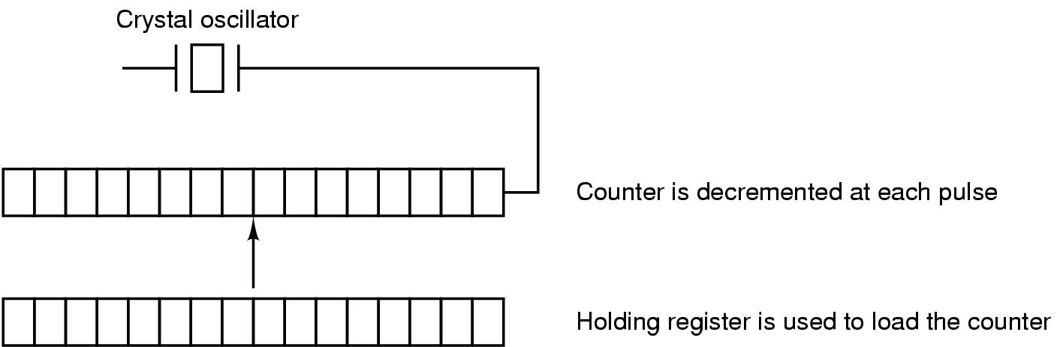
Clocks
Clock Hardware
A programmable clock

Slide 40
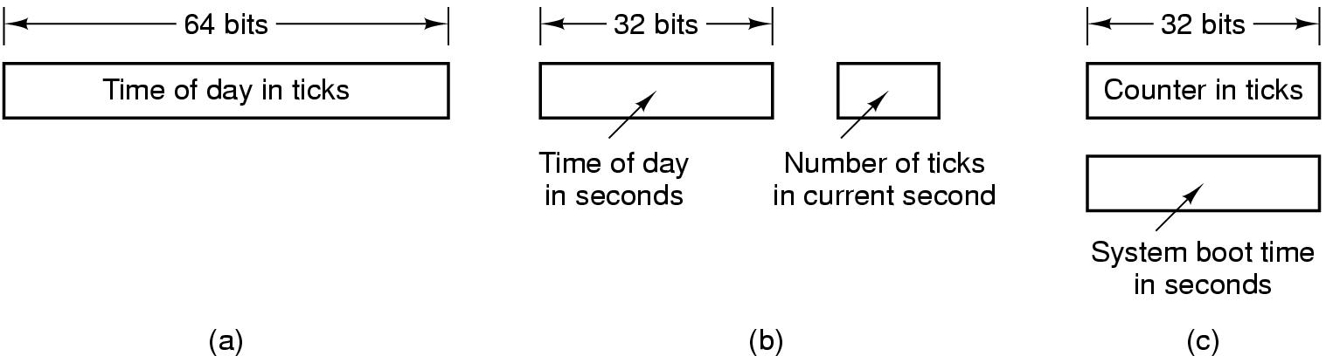
Clock Software (1)
Three ways to maintain the time of day

Slide 41
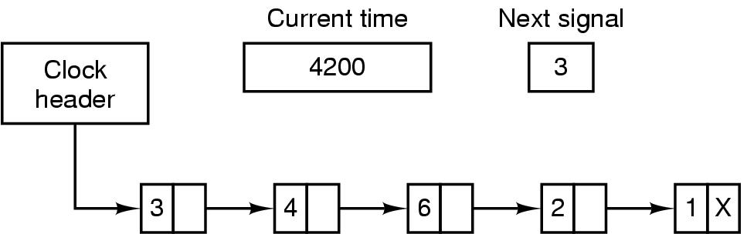
Clock Software (2)
Simulating multiple timers with a single clock

Slide 42
Soft Timers
A second clock available for timer interrupts
  specified by applications
  no problems if interrupt frequency is low
Soft timers avoid interrupts
  kernel checks for soft timer expiration before it exits to user mode
  how well this works depends on rate of kernel entries

Slide 43
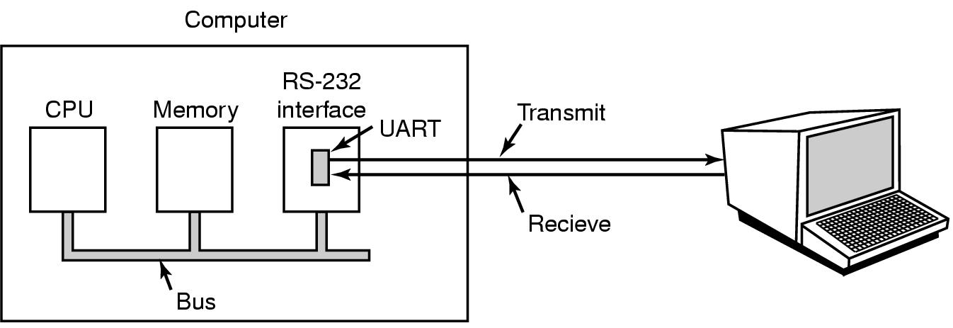
Character Oriented Terminals
RS-232 Terminal Hardware
An RS-232 terminal communicates with computer 1 bit at a time
Called a serial line – bits go out in series, 1 bit at a time
Windows uses COM1 and COM2 ports, first to serial lines
Computer and terminal are completely independent

Slide 44
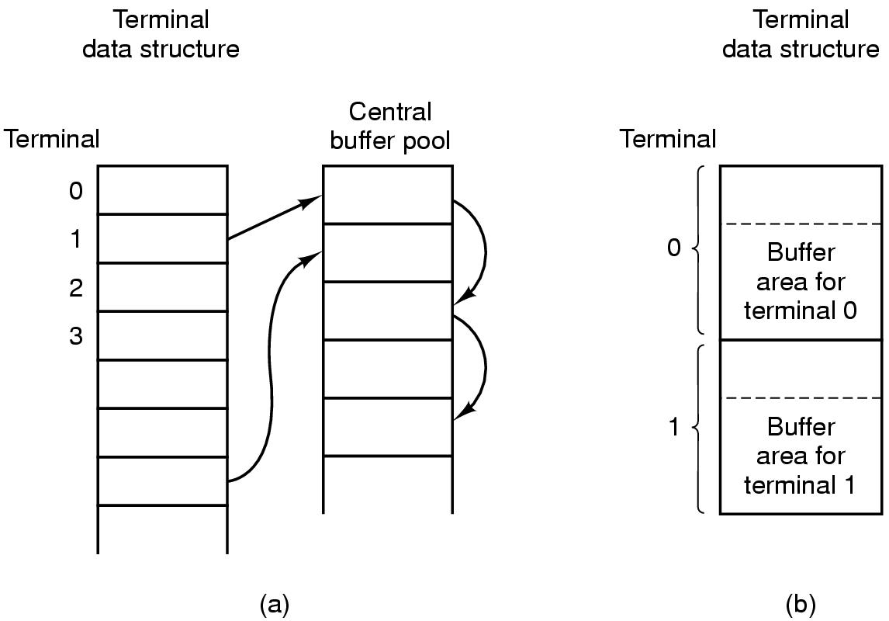
Input Software (1)
Central buffer pool
Dedicated buffer for each terminal

Slide 45
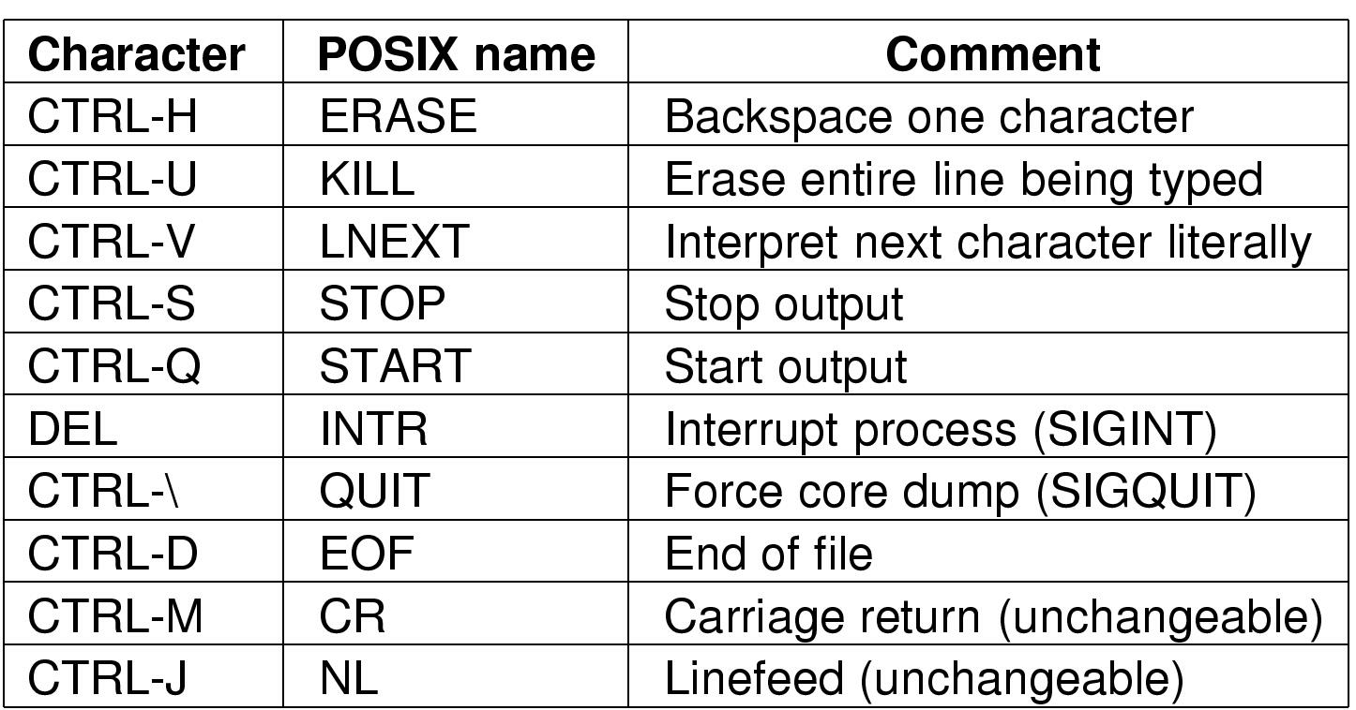
Input Software (2)
Characters handled specially in canonical mode

Slide 46
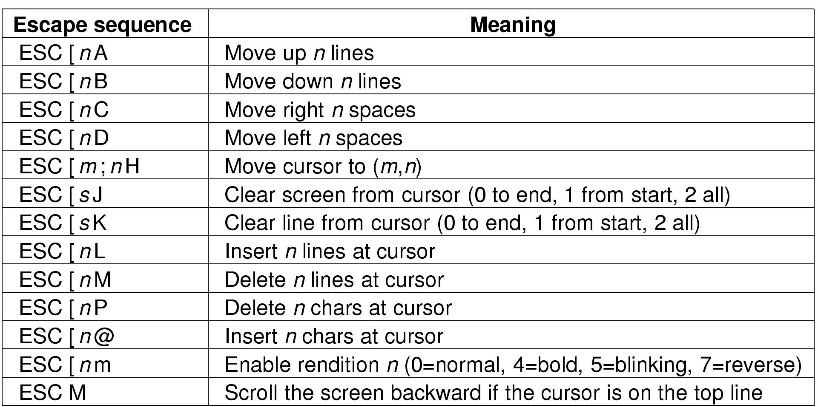
Output Software
The ANSI escape sequences
accepted by terminal driver on output
ESC is ASCII character (0x1B)
n,m, and s are optional numeric parameters

Slide 47
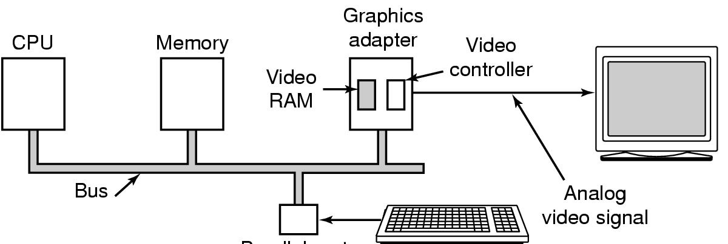
Display Hardware (1)
Parallel port
Memory-mapped displays
driver writes directly into display's video RAM

Slide 48
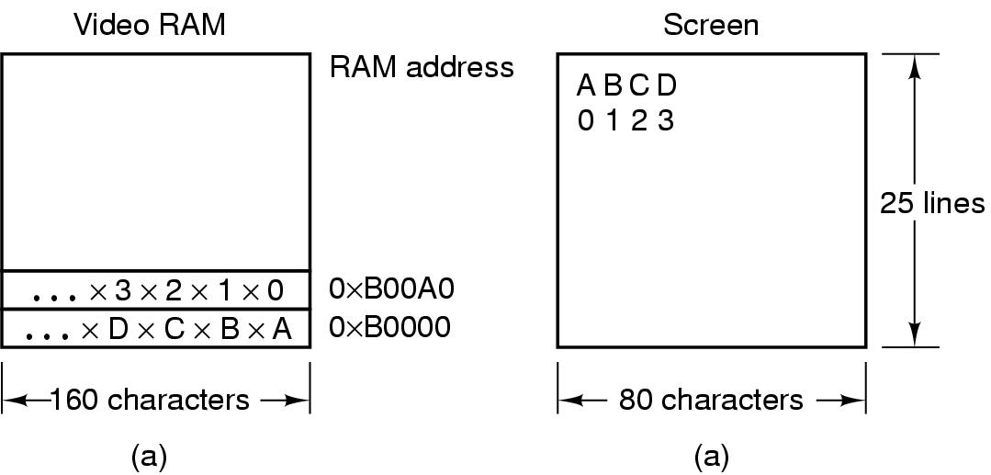
Display Hardware (2)
A video RAM image
  simple monochrome display
  character mode
Corresponding screen
  the xs are attribute bytes

Slide 49
Input Software
Keyboard driver delivers a number
  driver converts to characters
  uses a ASCII table
Exceptions, adaptations needed for other languages
  many OS provide for loadable keymaps or code pages

Slide 50
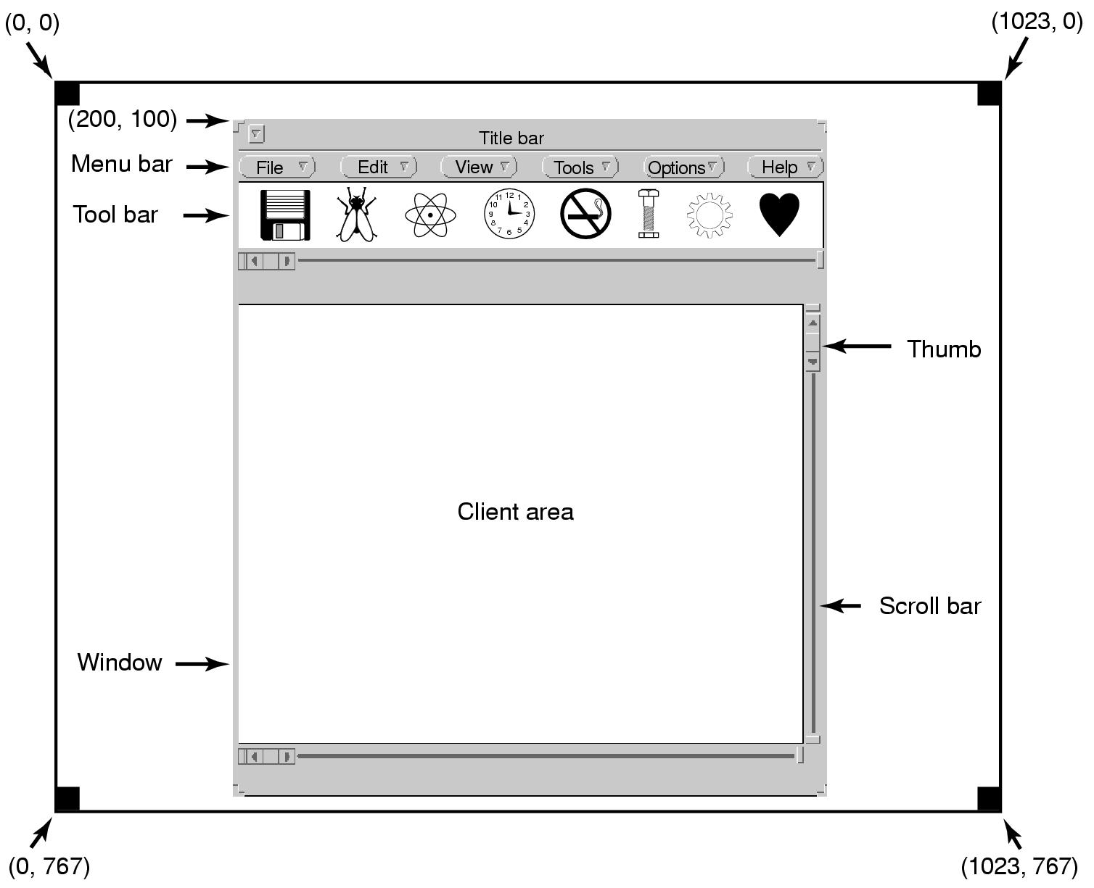
Output Software for Windows (1)
Sample window located at (200,100) on XGA display

Slide 51
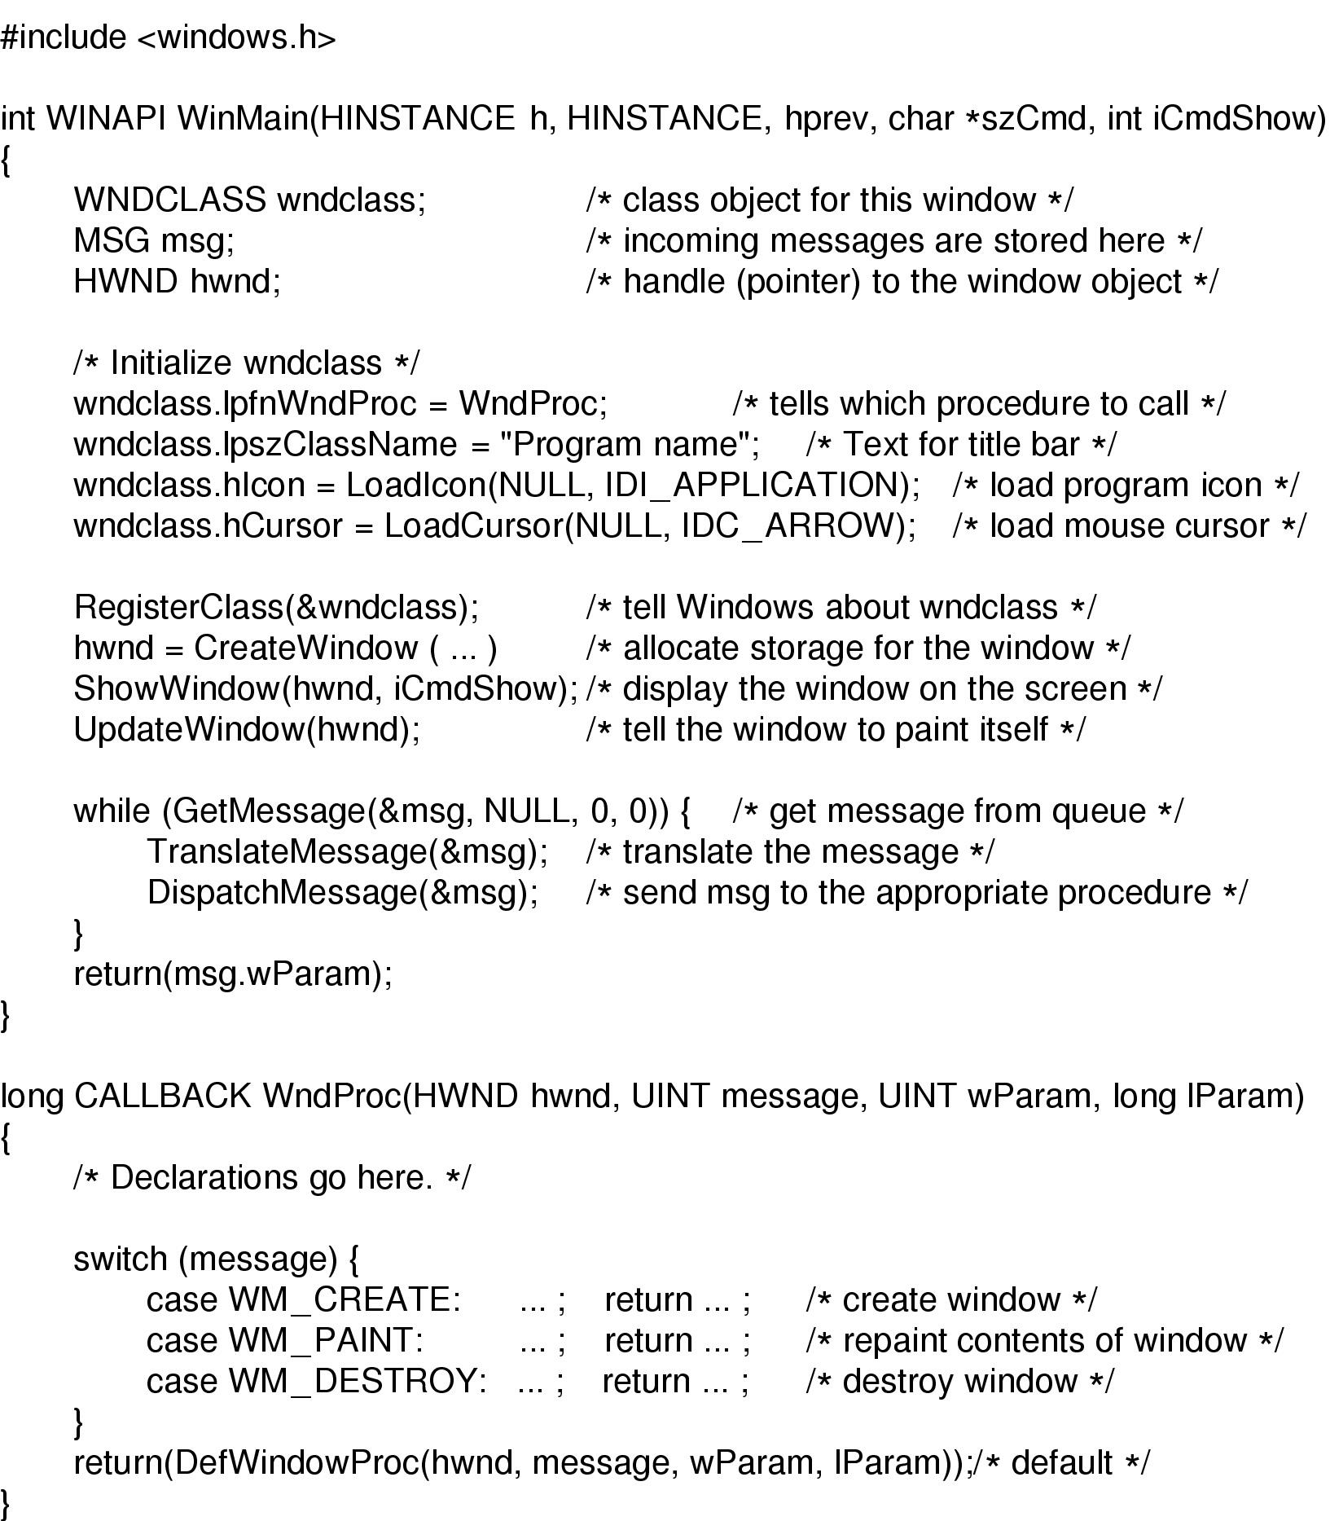
Output Software for Windows (2)
Skeleton of a Windows main program (part 1)

Slide 52
Output Software for Windows (3)
Skeleton of a Windows main program (part 2)

Slide 53
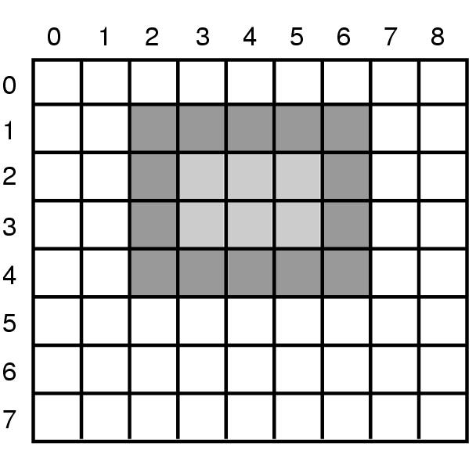
Output Software for Windows (4)
An example rectangle drawn using Rectangle

Slide 54
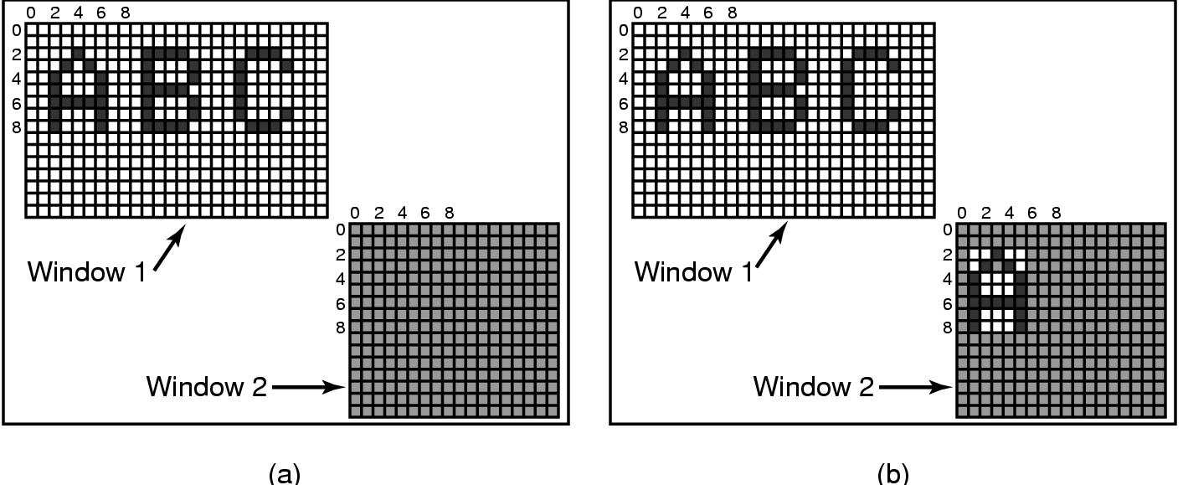
Output Software for Windows (5)
Copying bitmaps using BitBlt.
  before
  after

Slide 55
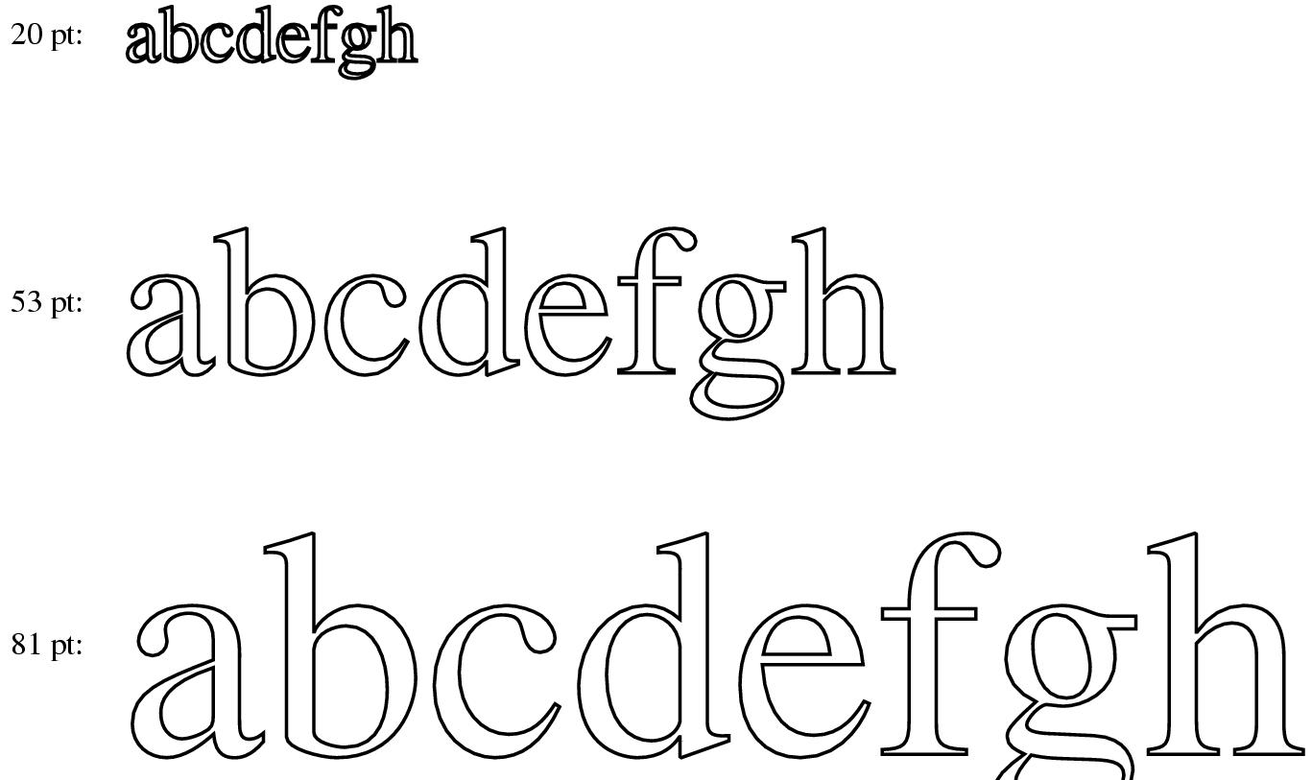
Output Software for Windows (6)
Examples of character outlines at different point sizes

Slide 56
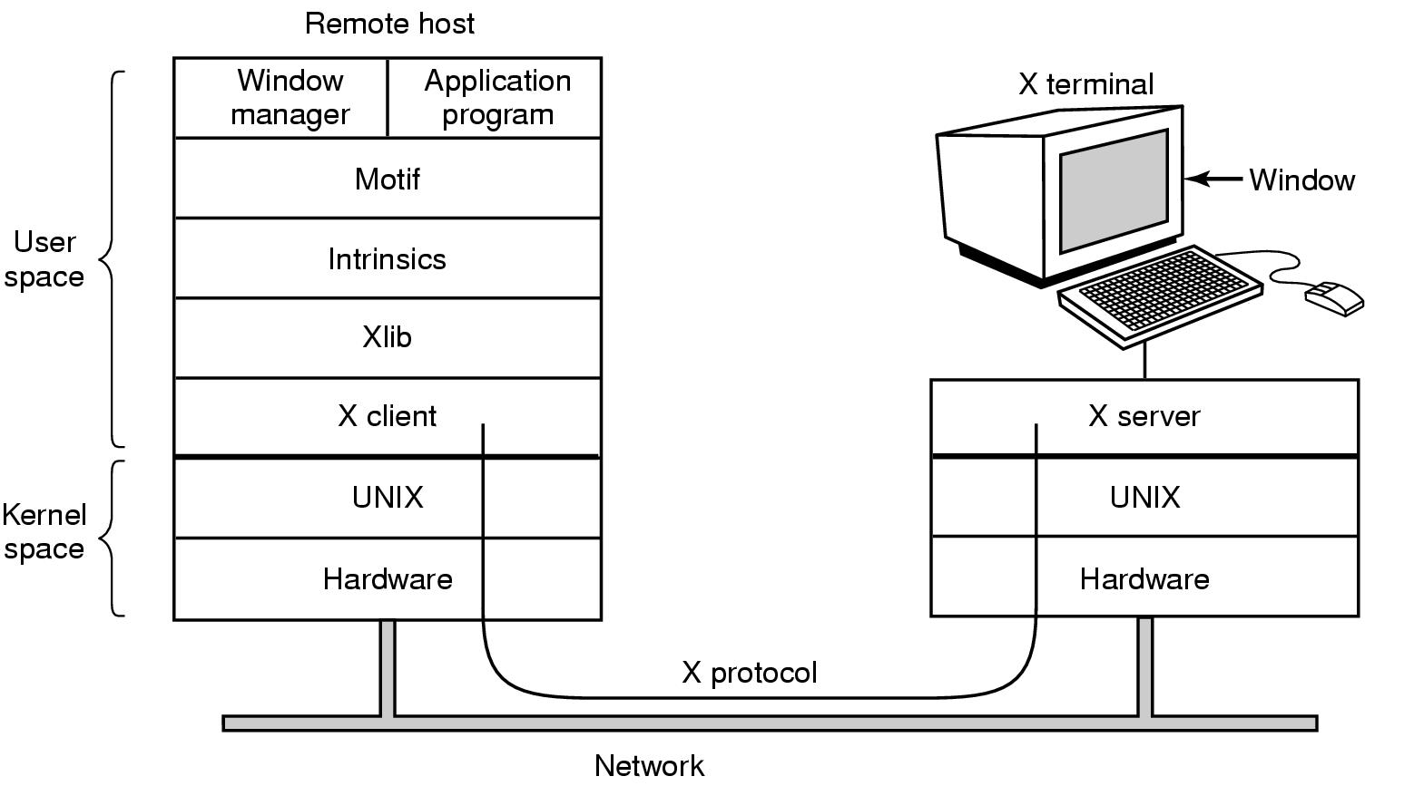
Network Terminals
X Windows (1)
Clients and servers in the M.I.T. X Window System

Slide 57
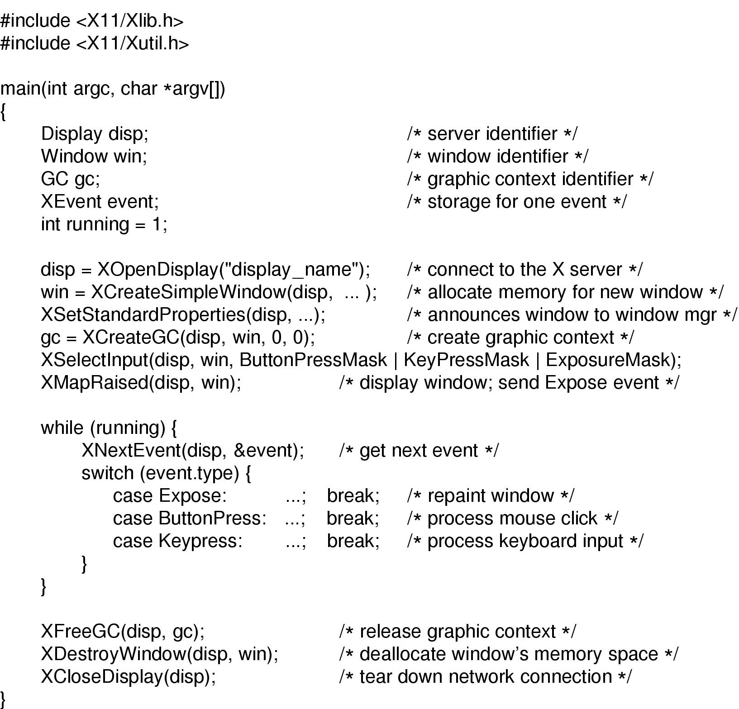
X Windows (2)
Skeleton of an X Windows application program

Slide 58
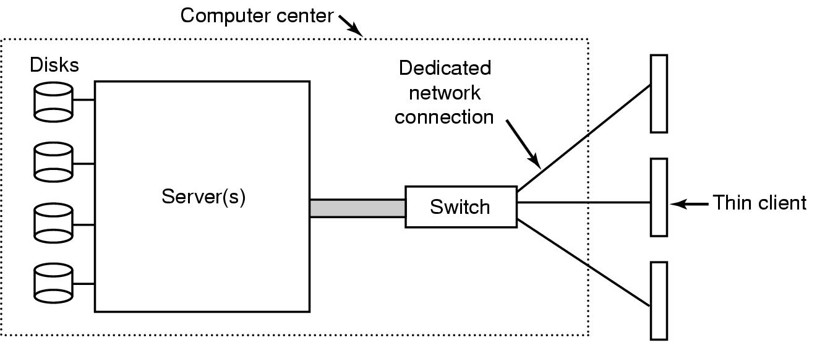
The SLIM Network Terminal (1)
The architecture of the SLIM terminal system

Slide 59
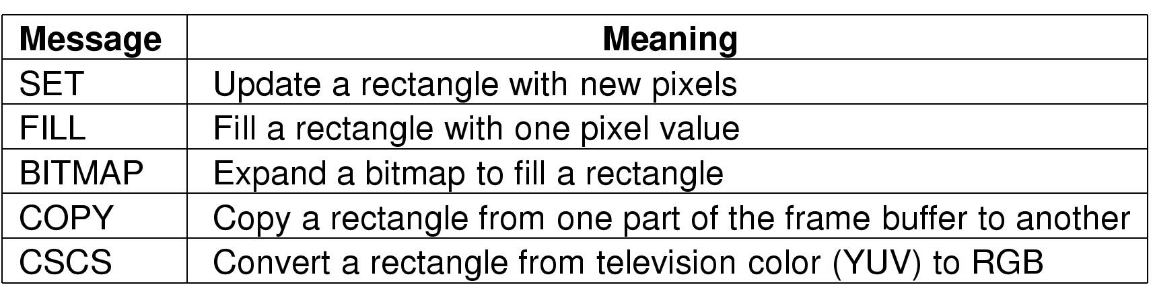
The SLIM Network Terminal (2)
Messages used in the SLIM protocol from the server to the terminals

Slide 60
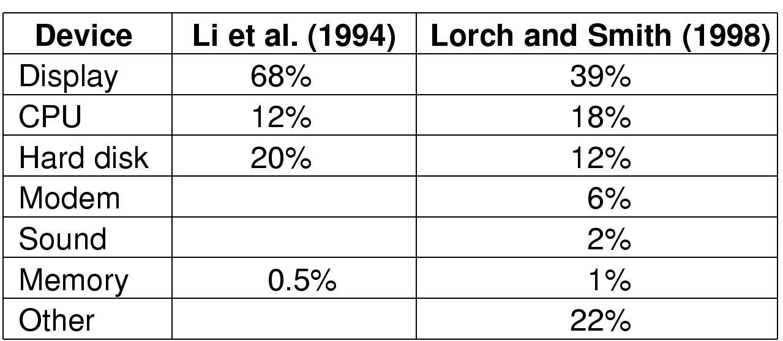
Power Management (1)
Power consumption of various parts of a laptop computer

Slide 61
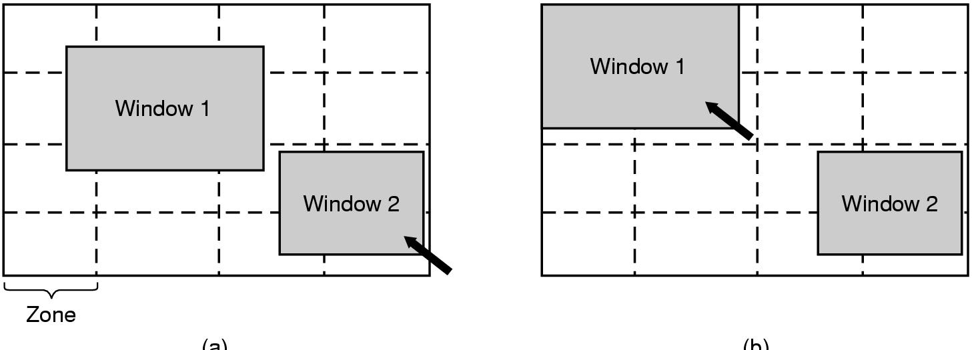
Power management (2)
The use of zones for backlighting the display

Slide 62
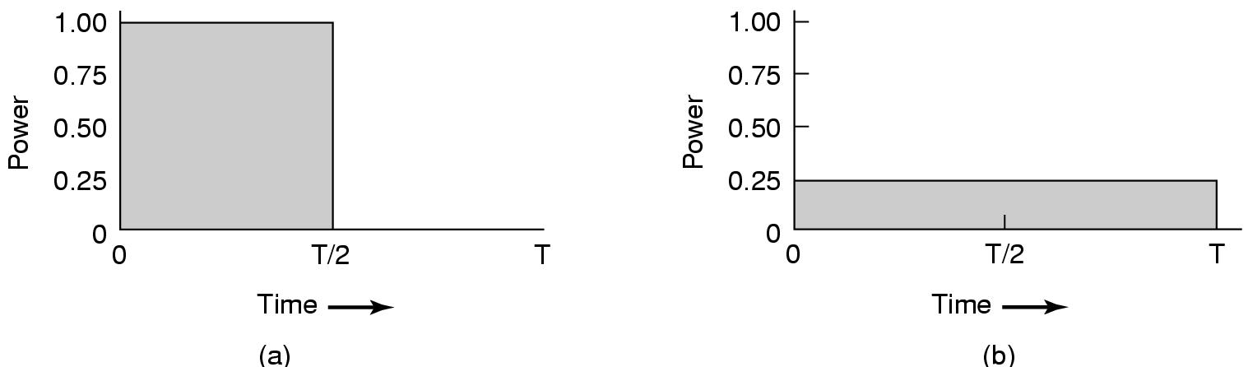
Power Management (3)
Running at full clock speed
Cutting voltage by two
  cuts clock speed by two,
  cuts power by four

Slide 63
Power Management (4)
Telling the programs to use less energy
  may mean poorer user experience
Examples
  change from color output to black and white
  speech recognition reduces vocabulary
  less resolution or detail in an image

